Slide 1
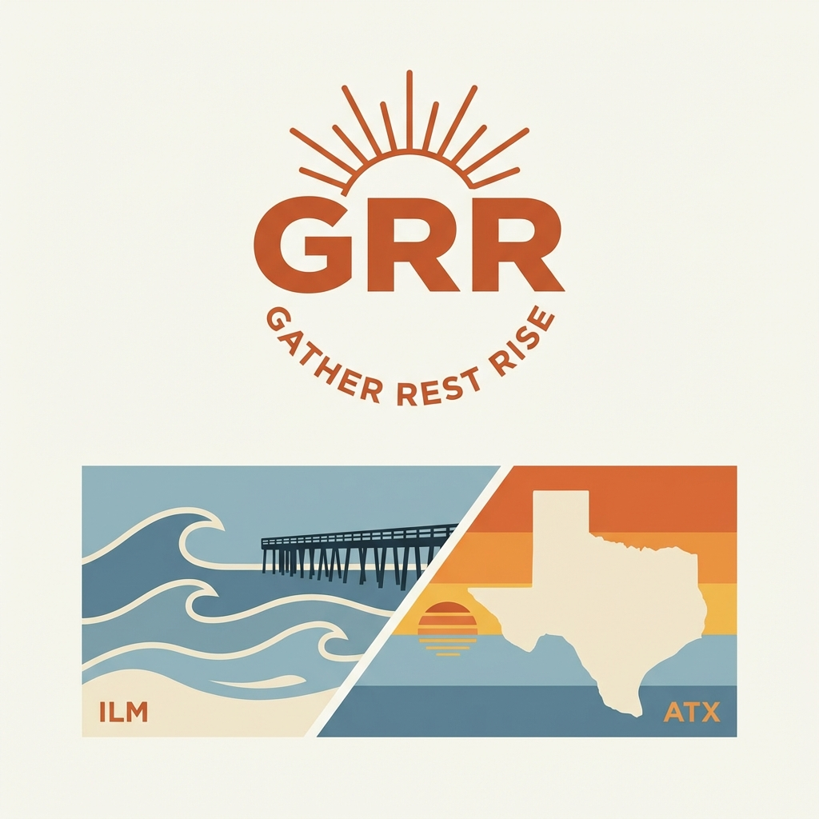
GRR
GATHER
REST
RISE
Premium Lifestyle Apparel

Slide 2
01
THE STORY
Two places.
One philosophy.
Wilmington, NC Morning paddle-outs. Family dinners at sunset. Austin, TX Dawn gym sessions. Home for what matters. For those who refuse to choose.

Slide 3
02
THE MEANING
GATHER
REST
RISE
Family. Friends. Community.
Recovery is strategy.
Stronger every day.
This is your fuel.
Your best work follows rest.
Gym. Work. Family.
Gather. Rest. Rise.

Slide 4
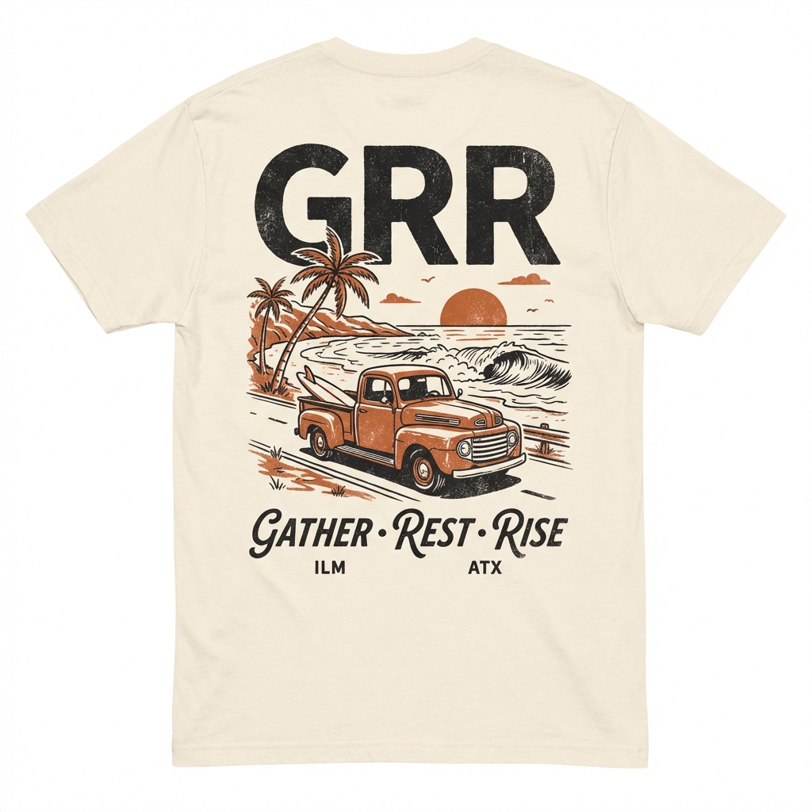
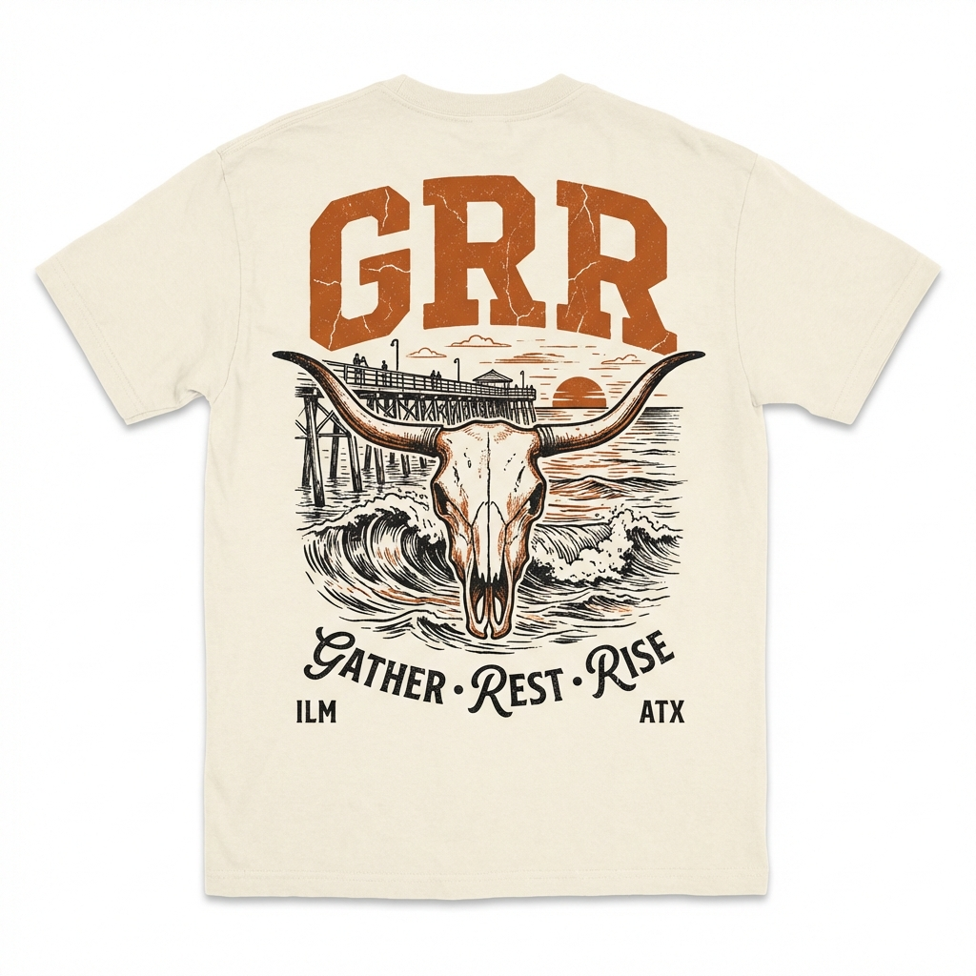
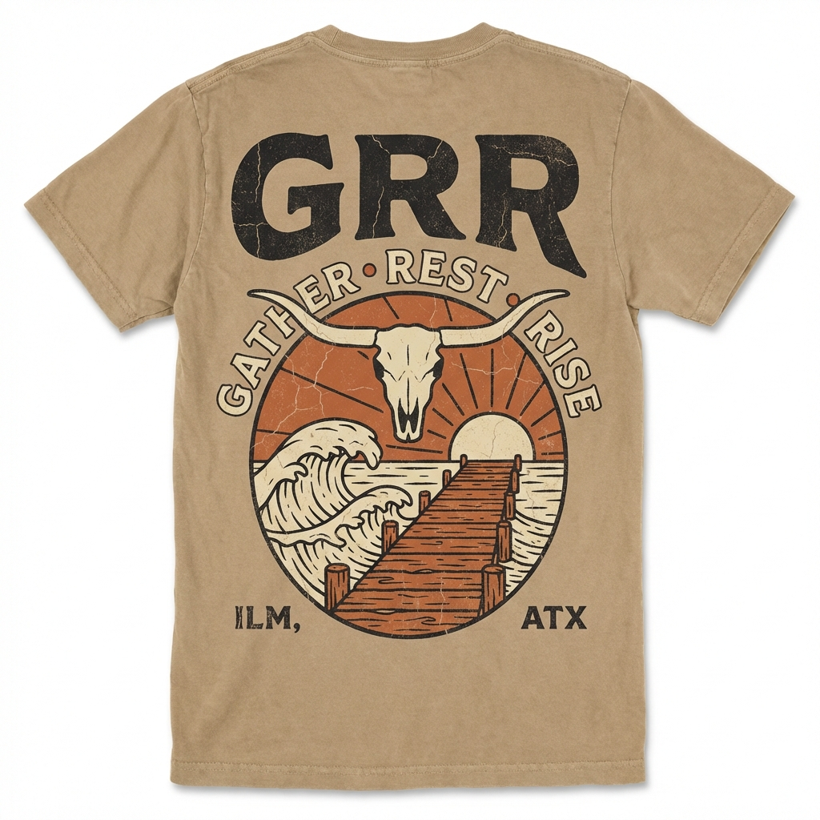
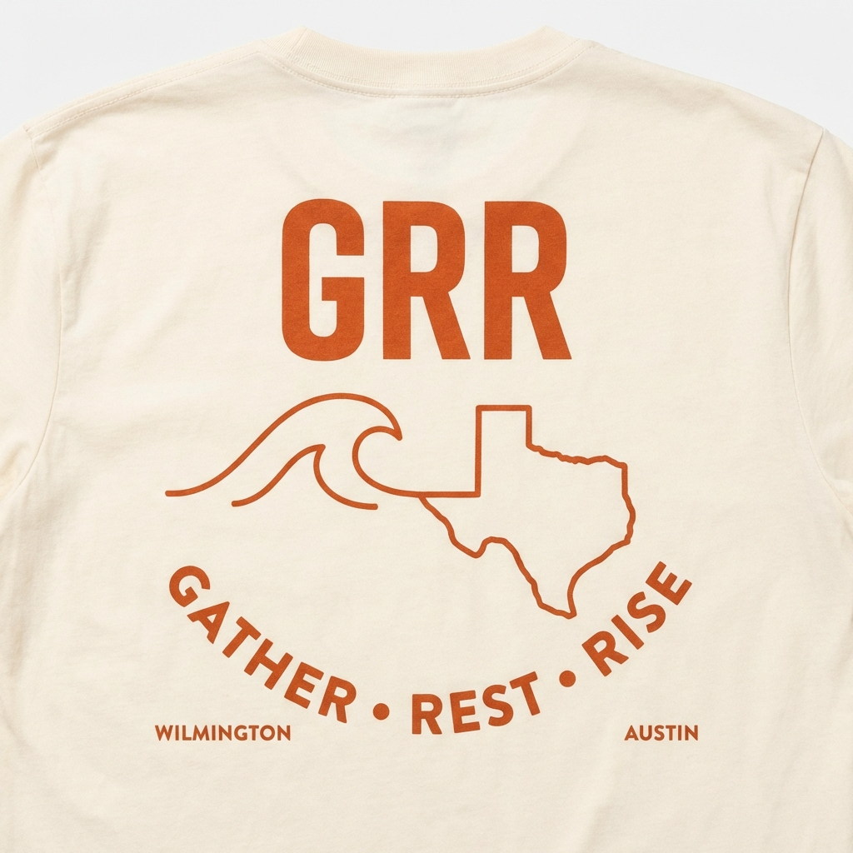
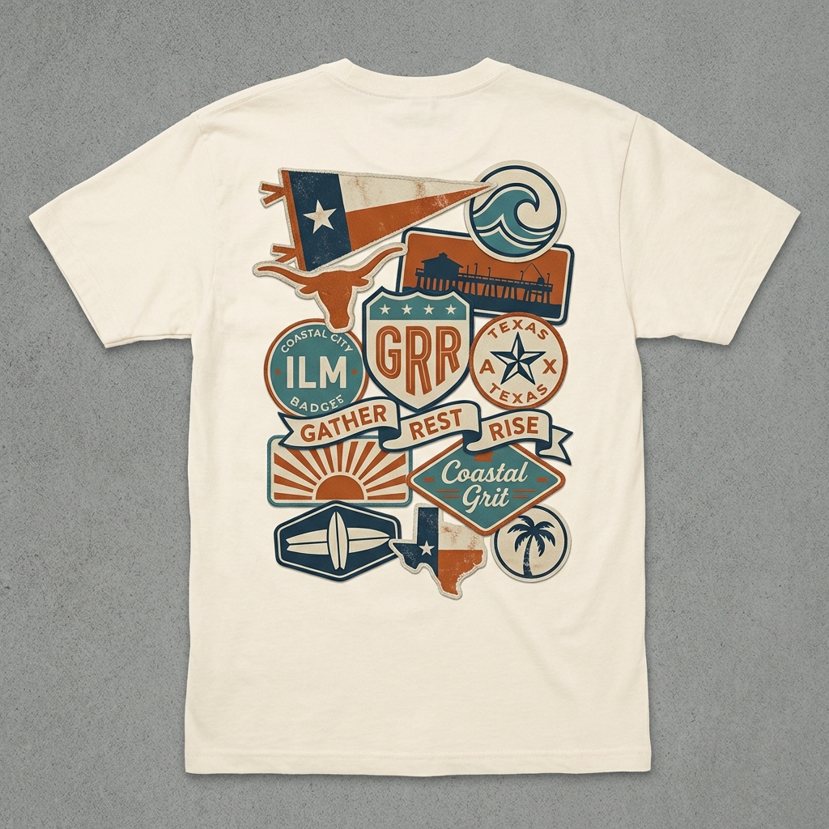
03
THE COLLECTION
$45 • 100% Cotton • Premium Fit
BEACH TRUCK
LONGHORN PIER
VINTAGE SKULL
WAVE + TEXAS
STICKER BOMB
ILM × ATX
Two roots. One identity.

Slide 5
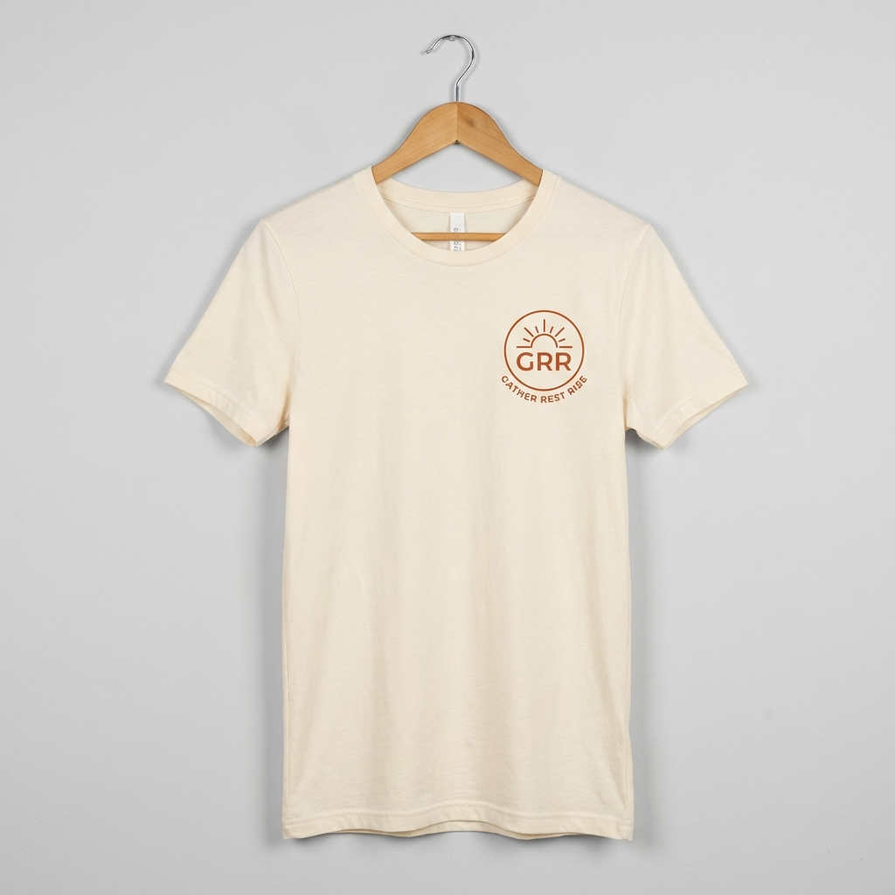
04
BEACH TRUCK
Vintage soul meets coastal freedom
FRONT
BACK

Slide 6
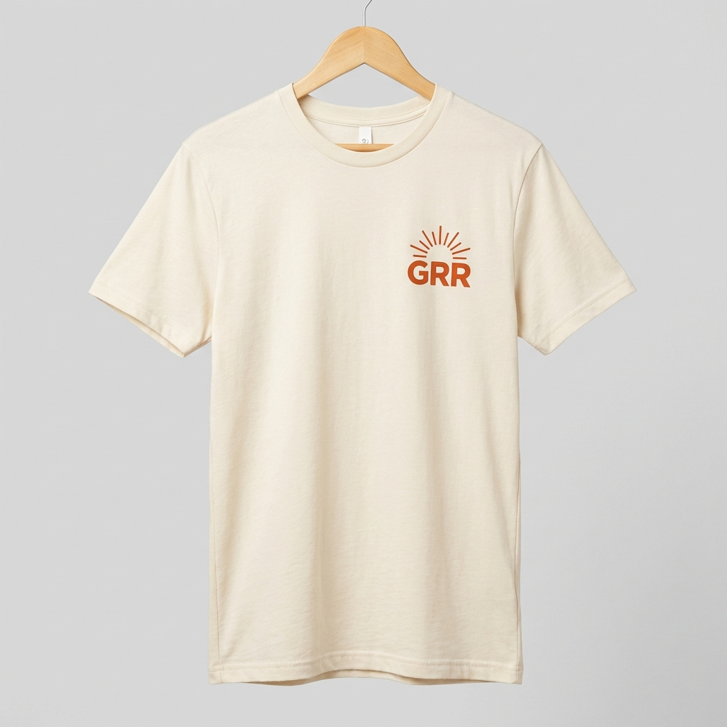
05
LONGHORN PIER
Texas pride meets ocean tide
FRONT
BACK

Slide 7
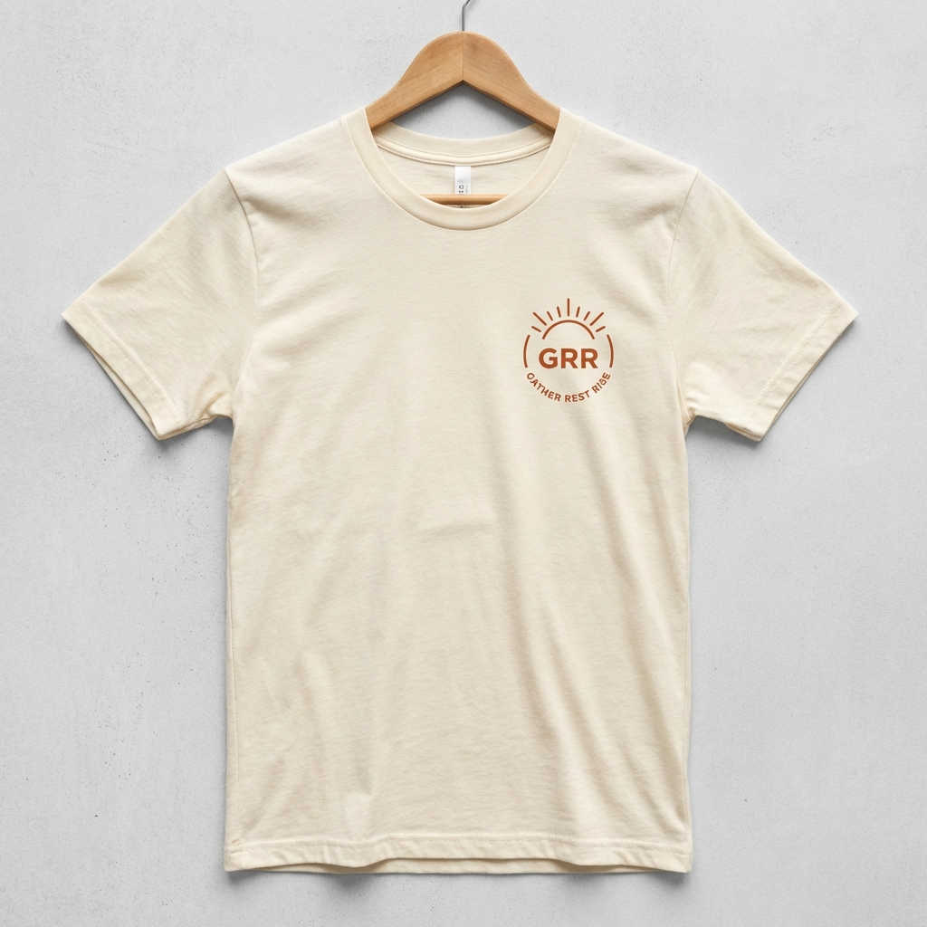
06
VINTAGE SKULL
Heritage. Grit. Timeless.
FRONT
BACK

Slide 8
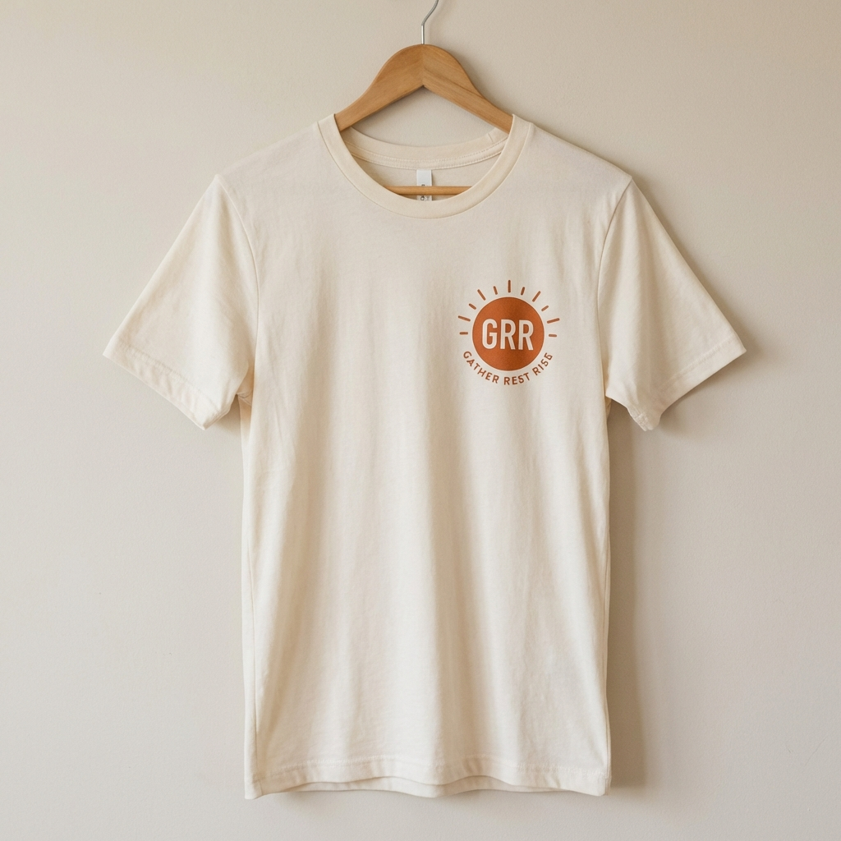
07
WAVE + TEXAS
Clean lines. Bold roots.
FRONT
BACK

Slide 9
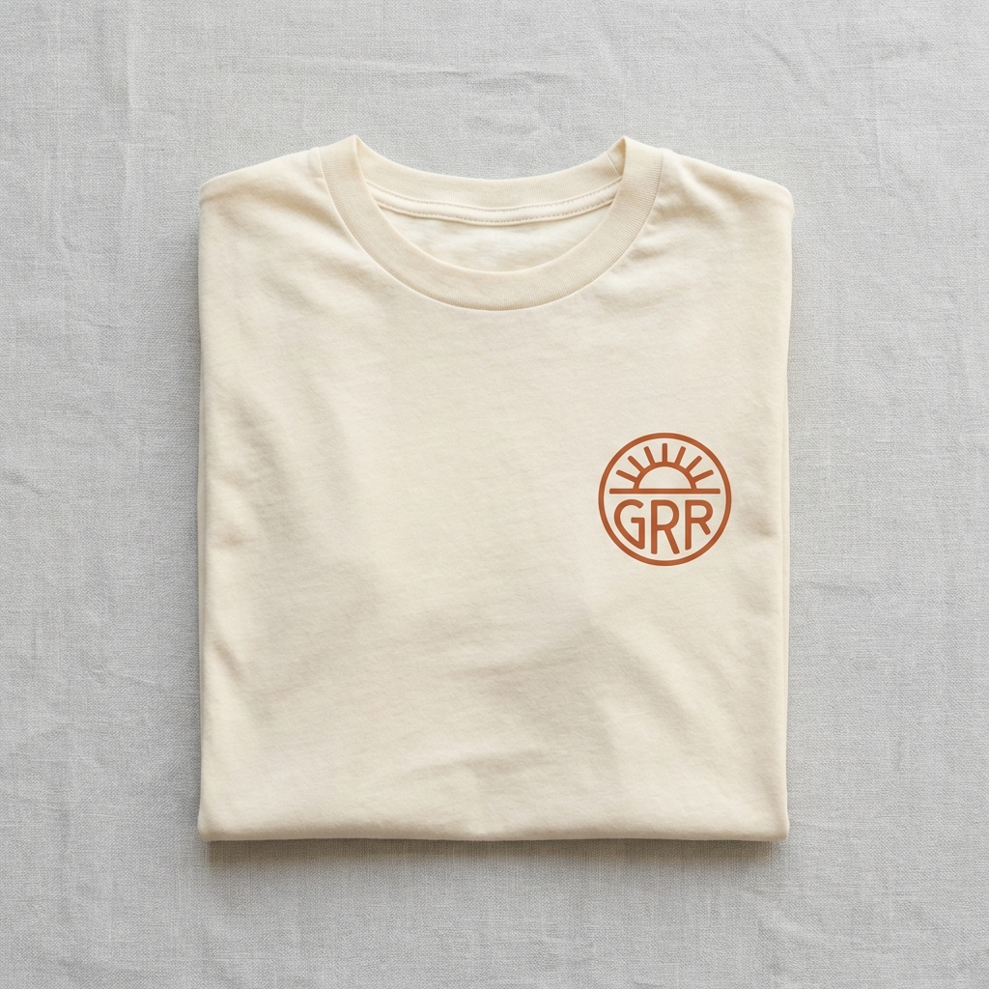
08
STICKER BOMB
Every badge tells a story.
FRONT
BACK

Slide 10
09
WHO WE SERVE
The Active Parent
Gym before the house wakes. Quality time over screen time.
The Coastal Texan
Beach roots. Texas pride. Authenticity over trends.
The Balanced Builder
Career and life. Burnout isn't a badge.

Slide 11
GRR
Gather. Rest. Rise.
Premium lifestyle apparel for those who
work hard and live well.
Let's build this together.
ILM × ATX

